Slide 1
OGC API – Features formerly known as “WFS 3.0”
OGC API Hackathon 2019
London, United Kingdom
20 June 2019

Slide 2
OGC API – Features
OGC API standards define modular API building blocks to spatially enable Web APIs in a consistent way
OGC API Features specifies the fundamental API building blocks for interacting with features (create, modify and query features on the Web)
Started as a revision of the OGC Web Feature Service standard that
proposes a modernized service architecture,
leverages the OpenAPI specification,
follows the current Web architecture and the (Spatial) Data on the Web Best Practices,
has a focus on the developer experience,
modularizes WFS into building blocks for fine-grained access to spatial data that can be used in data APIs,
is developed in a open process doing all work in a public GitHub repository, early implementations, in-depth validation, slow release

Slide 3
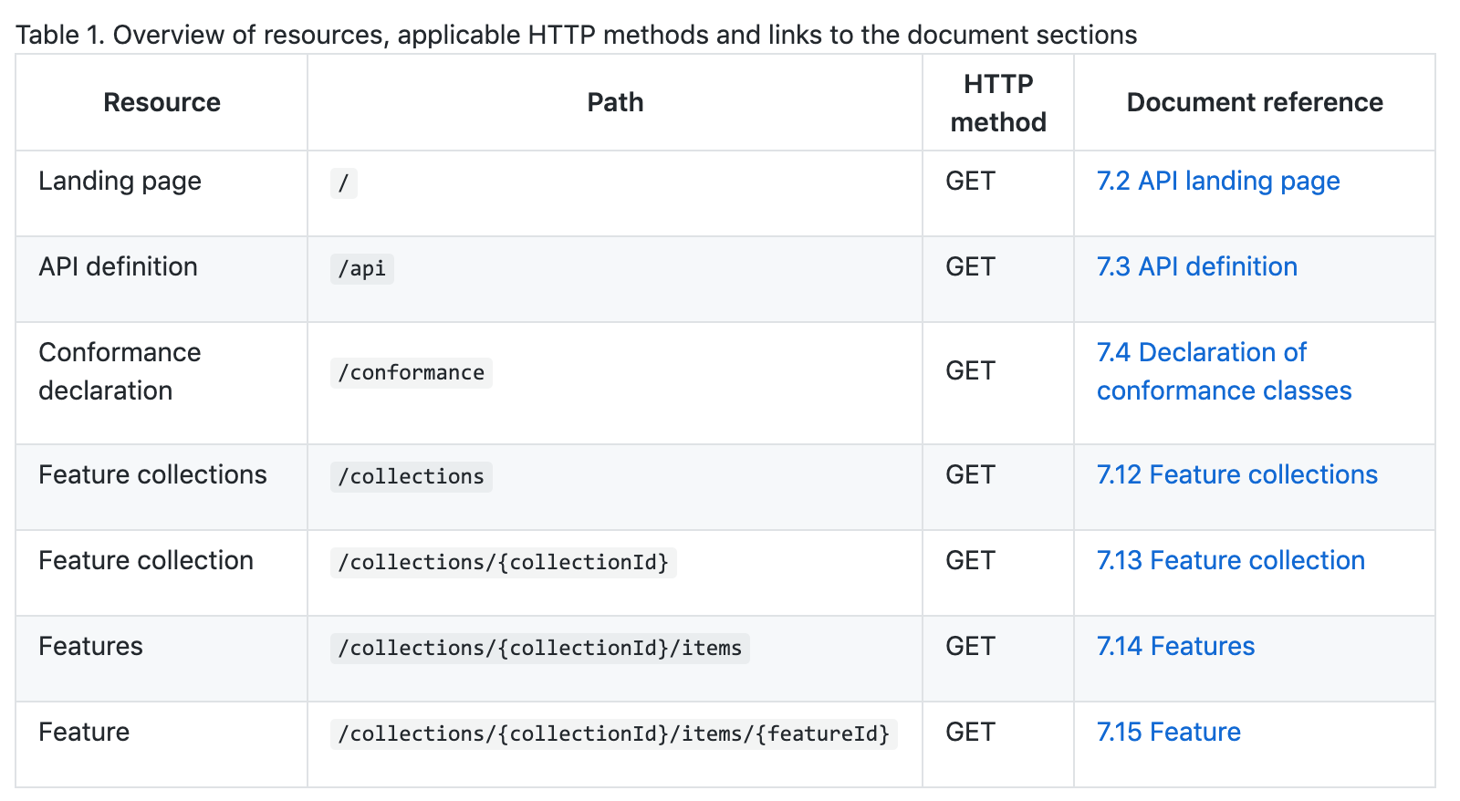
OGC API – Features – Part 1: Core Resources of the Web API
information
about the API
a dataset with a sub-division into
named collections of features
the features
http://docs.opengeospatial.org/DRAFTS/17-069r1.html#tldnr

Slide 4
OGC API – Features – Part 1: Core Schedule
OGC API
Hackathon
Initial OGC discussion
OGC API discussions
Implementations of extensions and other resource types
Other resource types: Tiles, Maps, 3D Scenes, Processes, Styles, Coverages, ...
Feature extensions: CRS support, Geometry simplification, Property selection, Filtering, ...
WFS 3.0
Hackathon
Core
OGC compliance tests
Core
OGC compliance tests
Initial Implementations
More implementations, public deployments
Core
1st Draft
Core
Validation and Testing
Core
Release Candidate
Approval process
OGC/ISO
Preparation
OGC Public review
April
2017
September
2017
April
2018
December
2018
July
2019
Standardization
Implementations
Notes:
Continued support for WFS 2.0 by OGC and ISO/TC 211
WFS 3.0 Core will be ISO 19168-1
A number of implementations already existed, before standardization
OGC API discussion progressing

Slide 5
OGC API – Features – Part 1: Core Current progress
70 issues closed
4 issues depend on actions by the OpenAPI Initiative
Default action will be decided in Leuven next week
4 issues marked for OGC API Hackathon input
See next slide
Final editing planned for July
Update of the Abstract Test Suite
Update contributors/submitters
Collect examples
Add anchors for examples
https://github.com/opengeospatial/WFS_FES/projects/1

Slide 6
OGC API – Features – Part 1: Core Expectations
The draft OGC API Common is currently consistent with OGC API Features
Please raise any concerns on Common now while we are still editing the Features spec
Issues marked for OGC API Hackathon input
We will keep the Core as it currently is unless there is a convincing case that the capability is important for most datasets / clients
#154: ability to express aggregation or other relationships between collections?
#228: tags/keywords for the API?
#231: “when” member in GeoJSON features for temporal information?
#233: do not use WGS 84 lat/lon(/h) as the common default CRS for providing feature data?

